Slide 1
Chapter 10_3 Light In the medical
Dr rafid albadr |

Slide 2
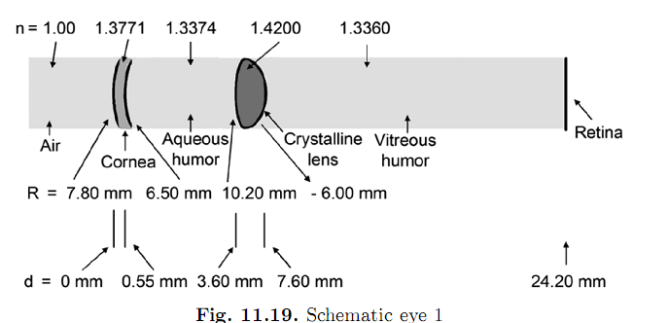
Geometrical optics of the eye

Slide 3
Geometrical optics of the eye
Eye defects
Normal eye ≡ emmentropic eye
• relaxed (focus on far distance object): D ~50
• focused at near point : D ~54
• near point ~25 cm (age dependent)
• far point (greatest distance at which good focus can be obtained): infinity
Any defects from normal sight are called ametropia

Slide 4
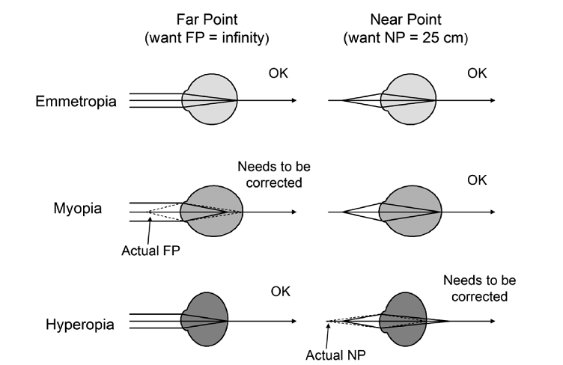
Geometrical optics of the eye
Eye defects

Slide 5
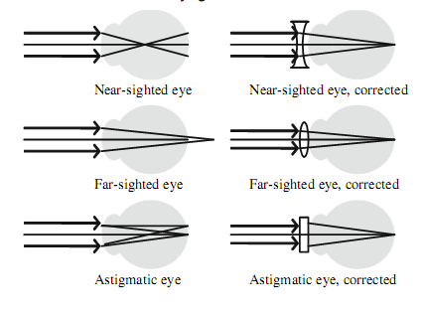
Geometrical optics of the eye
Eye defects

Slide 6
Geometrical optics of the eye
Eye defects

Slide 7
Geometrical optics of the eye
Eye defects

